Slide 1
Soldering and De-soldering
Digital Electronics
© 2014 Project Lead The Way, Inc.

Slide 2
Soldering & De-soldering
This presentation will…
Review the tools needed to solder and de-solder electronic components.
Demonstrate how to tin a soldering iron tip.
Demonstrate the soldering process.
Show the characteristics of a good solder connection.
Review classic soldering mistakes.
Demonstrate the de-soldering process.

Slide 3
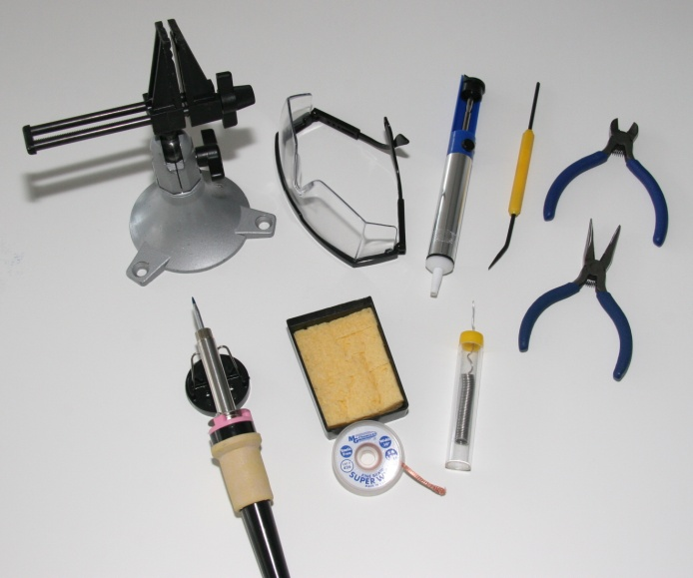
Soldering Tools
Vise
Safety glasses
Solder sucker
Solder tool
Diagonal cutters
Needle nose pliers
Solder
Solder wick
Damp sponge
Soldering iron
1
3
4
5
2
6
9
7
10
8

Slide 4
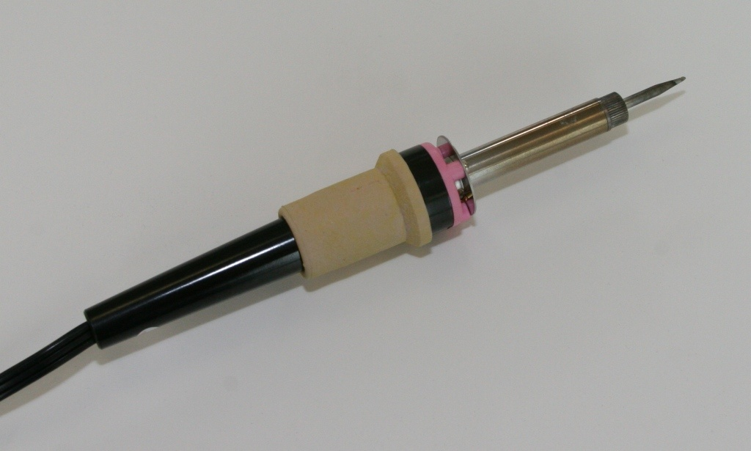
Soldering Iron
Typically 25-30 watts
Tip Temperature ≈750°F (400 °C)

Slide 5
Solder
Solder is an alloy of tin and lead.
The solder used for electronics is frequently called 60/40 solder because it is made of 63% tin and 37% lead.
60/40 solder melts at 361° F.
Lead-free solder: As of July 1st, 2006, European laws mandated that new electronics be entirely lead-free. As of yet, no such laws exist in the United States.

Slide 6
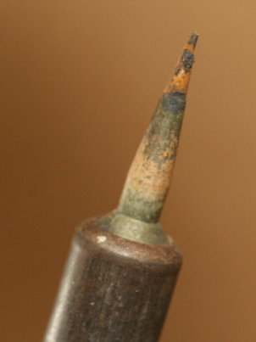
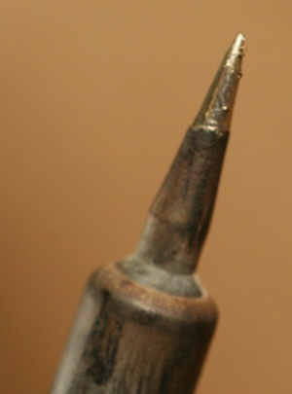
Soldering Iron Care & Maintenance
Un-Tinned
A soldering iron must be coated with a thin coat of solder. This will allow for the transfer of heat to the work piece.
This procedure is called tinning.
The tip must be kept coated with a shiny layer of solder by occasional wiping and applying solder directly to the tip.
Tinned

Slide 7
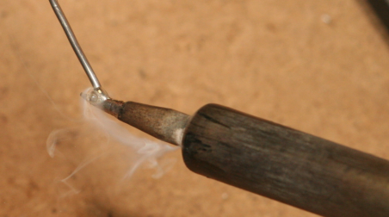
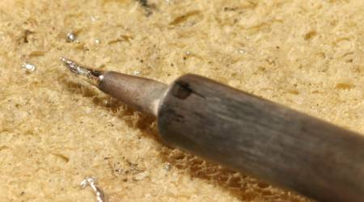
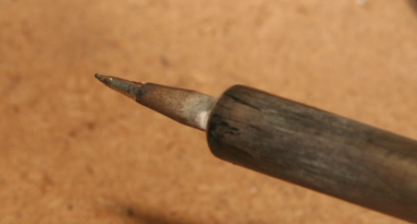
Tinning Process
Apply Solder to Soldering Iron Tip
Roll Tip on Damp Sponge
Properly Tinned Soldering Iron Tip
Notes:
.

Slide 8
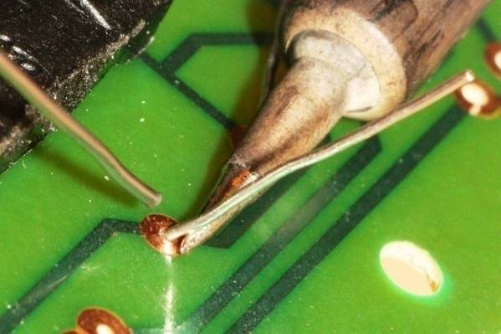
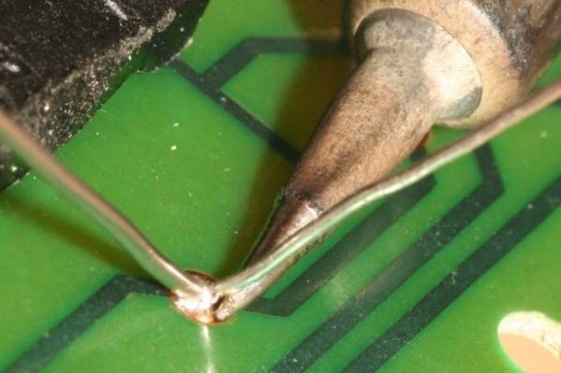
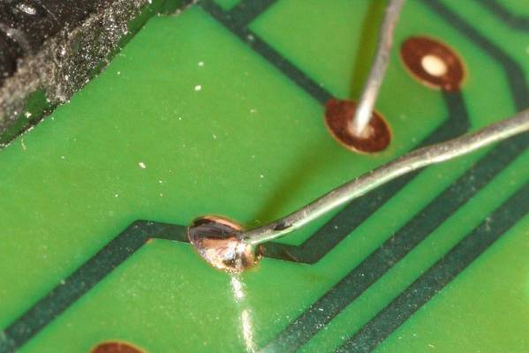
Solder Process
Heat both items at the same time by applying the soldering iron to the copper pad and the component lead.
1
Continue heating and apply a few millimeters of solder. Remove the iron and allow the solder joint to cool naturally.
2
It only takes a second or two to make the perfect joint, which should appear shiny.
3

Slide 9
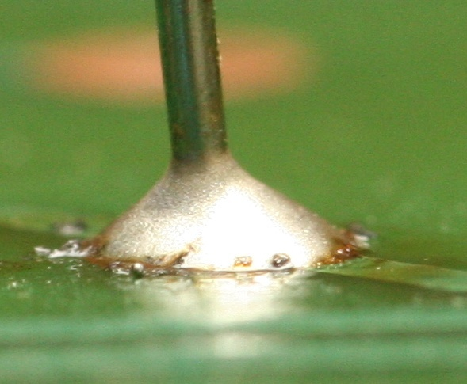
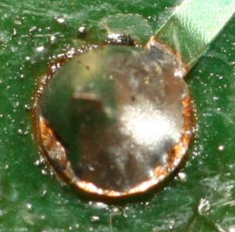
A Good Solder Joint
Smooth
Bright
Shiny
Clean
Concave fillet

Slide 10
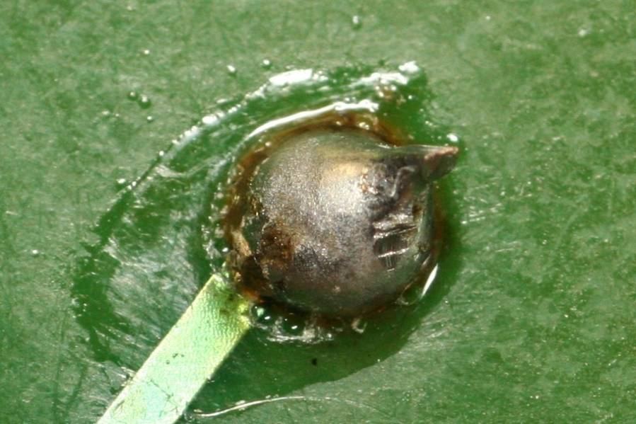
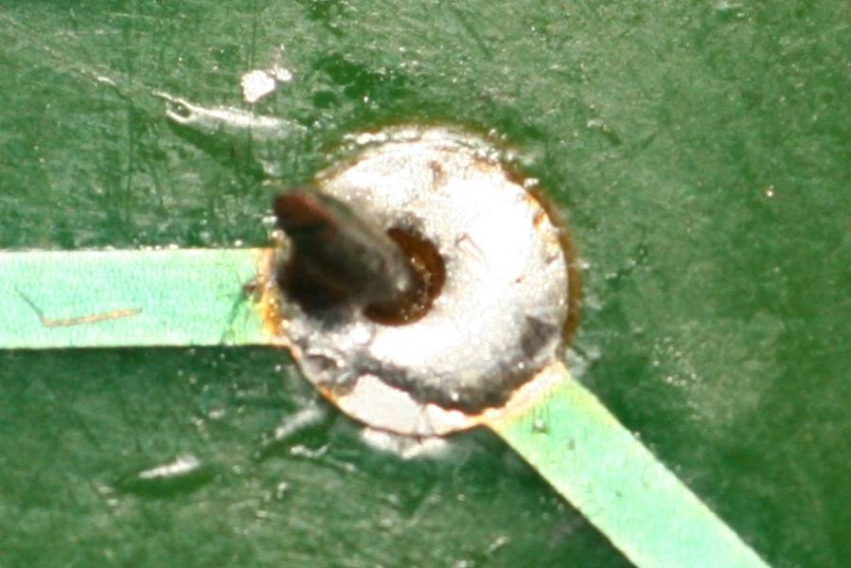
Bad Solder Connections
Too Much Solder
Too Little Solder

Slide 11
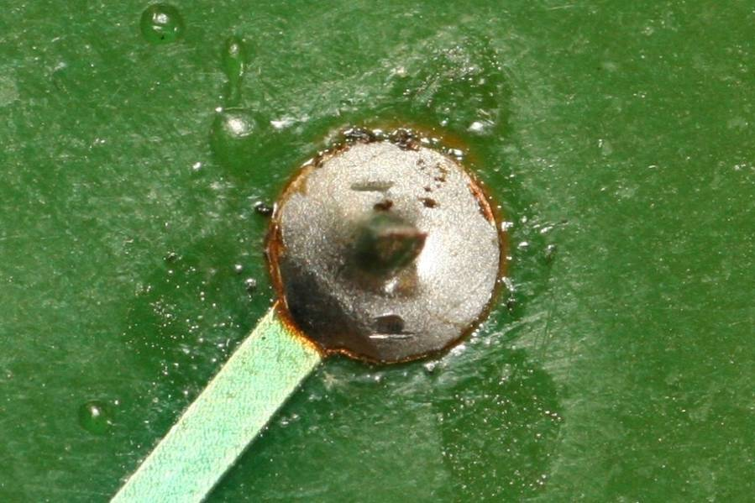
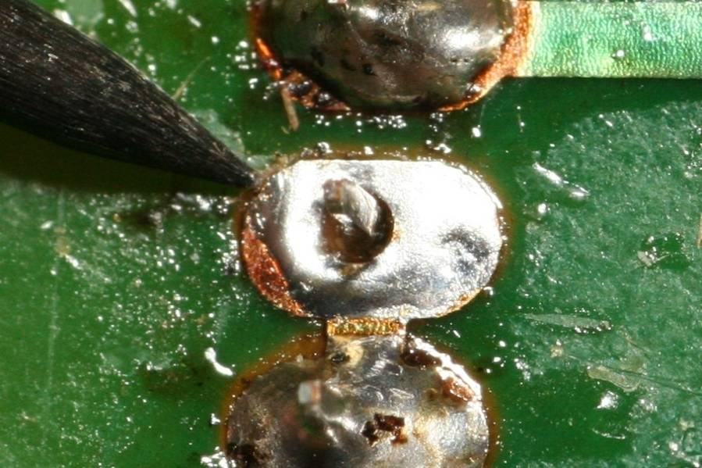
Bad Solder Connections
Cold Solder Joint
Not Soldered

Slide 12
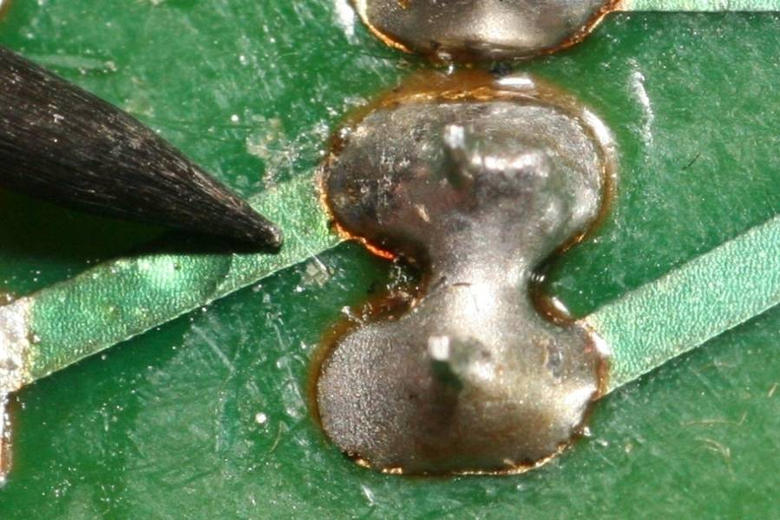
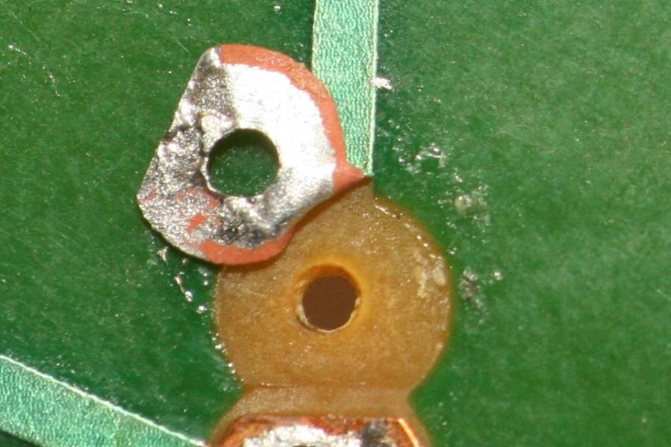
Bad Solder Connections
Solder Bridge
Lifted Trace/Pad

Slide 13
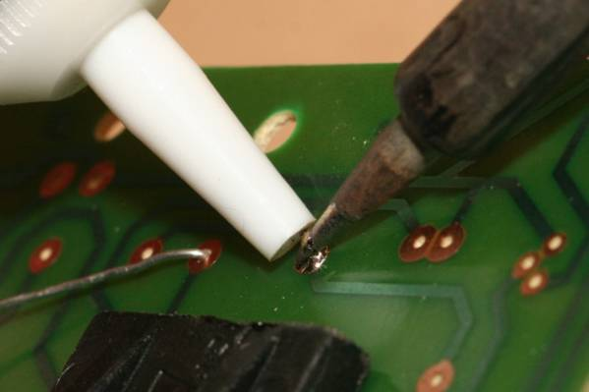
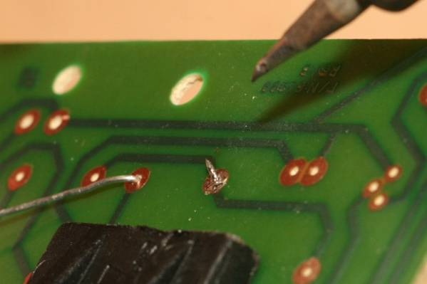
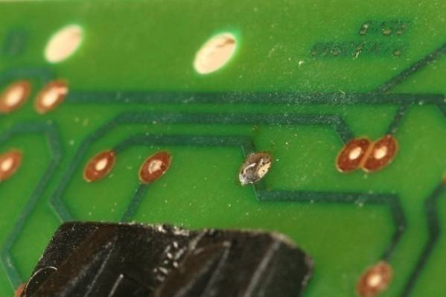
De-Solder Process: Solder Sucker
Apply heat to the connection to be de-soldered. When the solder melts, trigger the solder sucker.
1
Repeat de-soldering as needed until all solder is removed. Remove soldering iron & solder sucker from area.
2
Remove component lead.
3

Slide 14
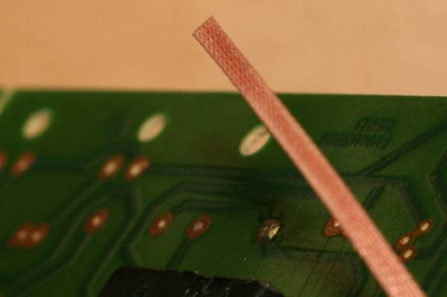
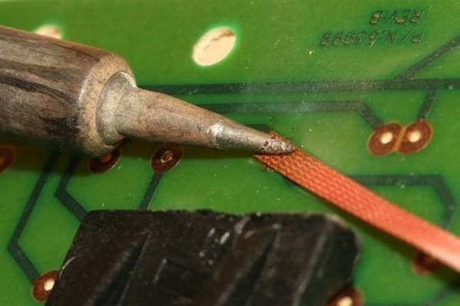
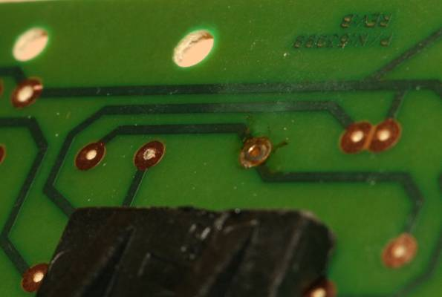
De-Solder Process: Solder Wick
Solder wick is finely braided copper that is used to wick away excess solder from a de-soldered connection.
1
Apply the solder wick and soldering iron to the de-soldered connection. The solder wick will draw the excess solder off of the PCB pad.
2
De-soldered PCB pad
3

Slide 15
Soldering Safety
Wear safety glasses when soldering. This includes all individuals in the vicinity of someone who is soldering.
Place soldering iron in an approved holder when not in use. The iron is hot and can cause burns.
Place the soldering iron so that the cord does not get caught up in your arms or on others.
Ensure access to proper ventilation.
Verify that the type of solder is safe to use in your working environment.
Secure the components to be soldered before beginning the soldering process.

Slide 16
Soldering Safety
Provide plenty of space to work.
Use a properly-sized point for the soldering job to be completed.
Verify that the tip on the soldering iron has a sharp point and has not been damaged in any way.
Check the power cord for burned or melted sections that show bare wires. Label those cords DO NOT USE and ask the instructor to repair or replace.
Do not to touch molten solder - it is hot!
Make sure that the solder strand is long enough to keep fingers away from the hot iron.

Slide 17
Soldering Safety
Tie back long hair and remove or tuck loose clothing.
Use heat sinks for heat-sensitive parts. Provide sufficient cooling time before removing parts.
Do not flick solder off of the iron. Flicking can cause solder to spray and hit skin or eyes.
Hold the scrap end when cutting excess leads so that the scrap lead is not thrown into the air.
Cut leads evenly with wire cutters.
Make sure that leads do not short across other traces or leads.
Thoroughly wash your hands after handling solder.

