Slide 1
Introduction to the Breadboard
Digital Electronics
© 2014 Project Lead The Way, Inc.

Slide 2
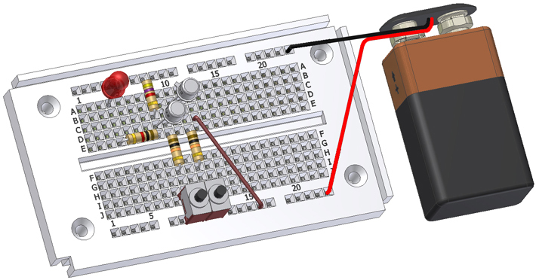
The Breadboard
This presentation will
Explain what a breadboard is.
Identify reasons for using a breadboard.
Review the guidelines and tips for proper breadboarding.

Slide 3
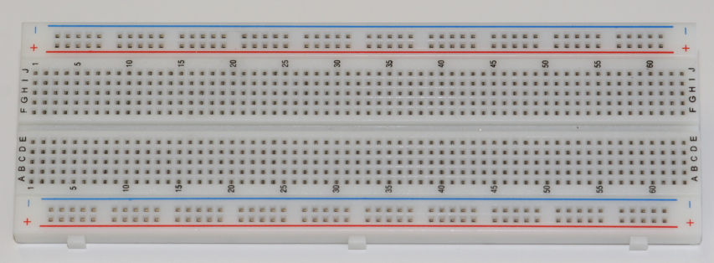
What is a Breadboard?
A breadboard, sometimes called a protoboard, is a reusable platform for temporarily building electronic circuits.
Notes:
.

Slide 4
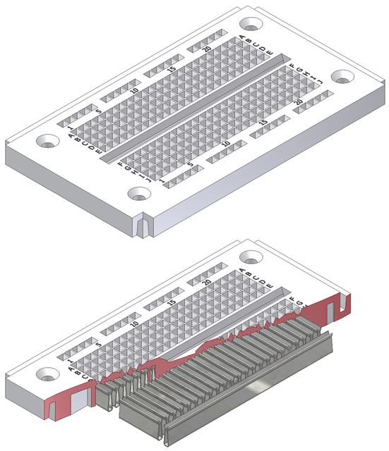
How A Breadboard Works
Electric component leads and the wire used to connect them are inserted into holes that are arranged in a grid pattern on the surface of the breadboard.
A series of internal metal strips serve as jumper wires. They connect specific rows of holes.
Top View
Cut-Away View

Slide 5
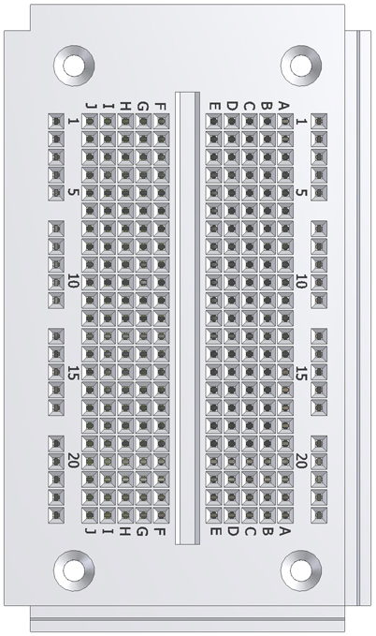
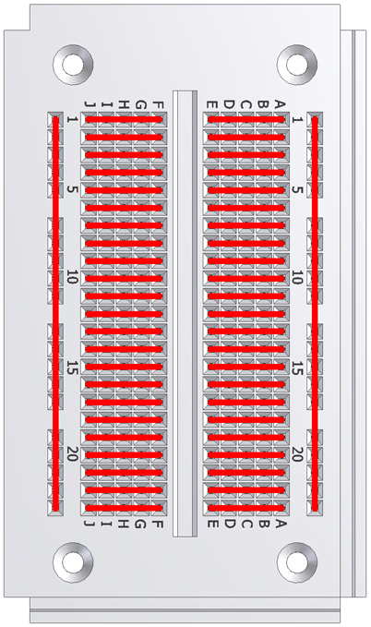
Breadboard Connections
Physical layout of
a breadboard
Red lines show
electrically connected holes

Slide 6
Why Breadboard?
The cost is lower and it takes less time to create a circuit using a breadboard than to design and fabricate a printed circuit board (PCB). The higher cost of a PCB should be reserved for the final working design.
As a complement to circuit simulation, breadboarding allows the designer to see how, and if, the circuit functions.

Slide 7
Why Breadboard?
A breadboard allows the designer to quickly change components during development and testing e.g. changing the value of a resistor or capacitor
A breadboard allows the designer to easily modify a circuit to facilitate measurements of voltage, current, or resistance.

Slide 8
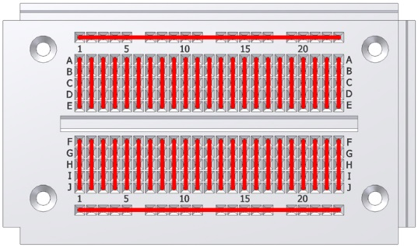
Breadboard: Guidelines and Tips
Use the breadboard internal metal strips to make the majority of the connections between components to minimize the use of jumper wires.
Minimize jumper wire length to avoid a jumble of wires which is difficult to troubleshoot.
Assemble the physical breadboard circuit so that it looks as close as possible to the layout of the schematic circuit to help with troubleshooting.

Slide 9
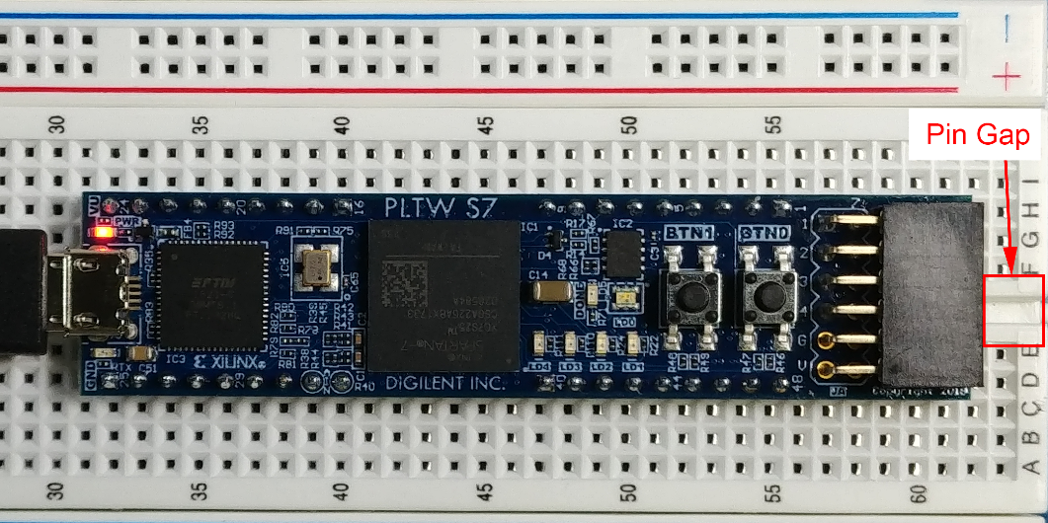
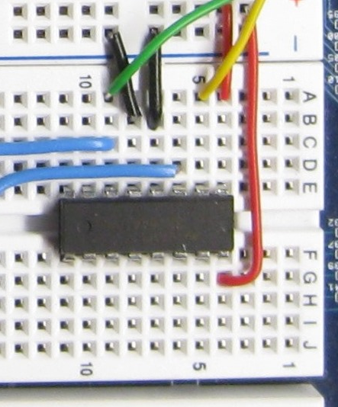
Breadboard: Guidelines and Tips
Place IC chips with pins straddling the gap between the pin rows.
Work from a schematic and check off each component and wire as they are added to the breadboard.
Have someone check your circuit for errors.

Slide 10
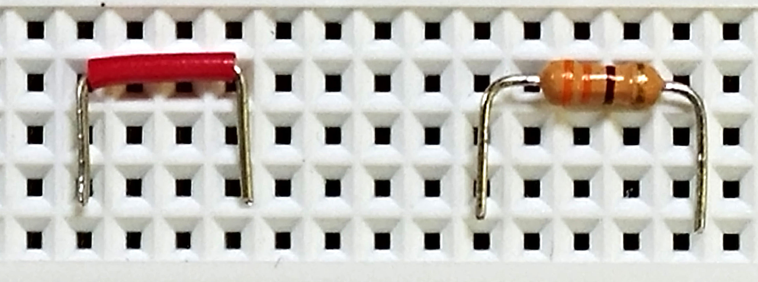
Breadboard: Guidelines and Tips
Cut component leads to manageable lengths to avoid unintended touching leading to a short circuit. The image shows an example of ¼ inch legs (~ 3 hole spaces) that is an ideal length that is insert into a breadboard hole.

